Slide 1
Multicultural Community Dementia Screening (MCS)
Biospecimen Collection and Shipment Training

Slide 2
Training Overview
Study Specimen Collection Overview
NCRAD Kit Request Module
Specimen Labeling Instruction
Specimen Collection and Processing
Specimen Packaging and Shipment Instruction
Creating Airbills and Scheduling Pickups
Non-Conformance Issues
Contact Information

Slide 3
MCS Specimen Collection
Samples will be collected and processed during Baseline Visit and during annual visit for 5-years.
Plasma and Buffy Coat will be frozen and shipped to NCRAD for all visits
Specimen Type | All Visits
Plasma | X
Buffy Coat (DNA) | X

Slide 4
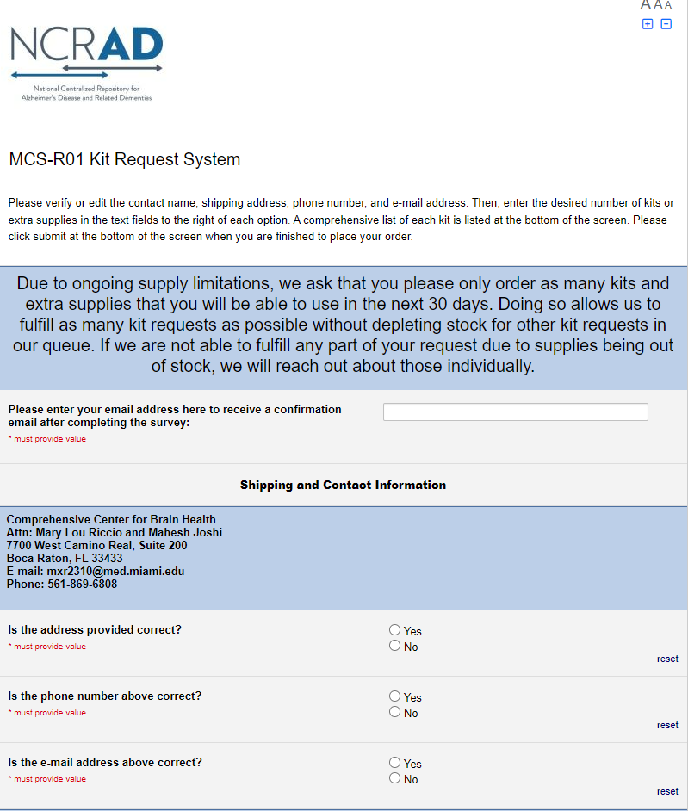
Kit Request Module
www.kits.iu.edu/MCS
Ordering blood kit supplies
Ordering frozen specimen shipment supplies
Please allow two to three weeks for orders to be processed and delivered to your site

Slide 5
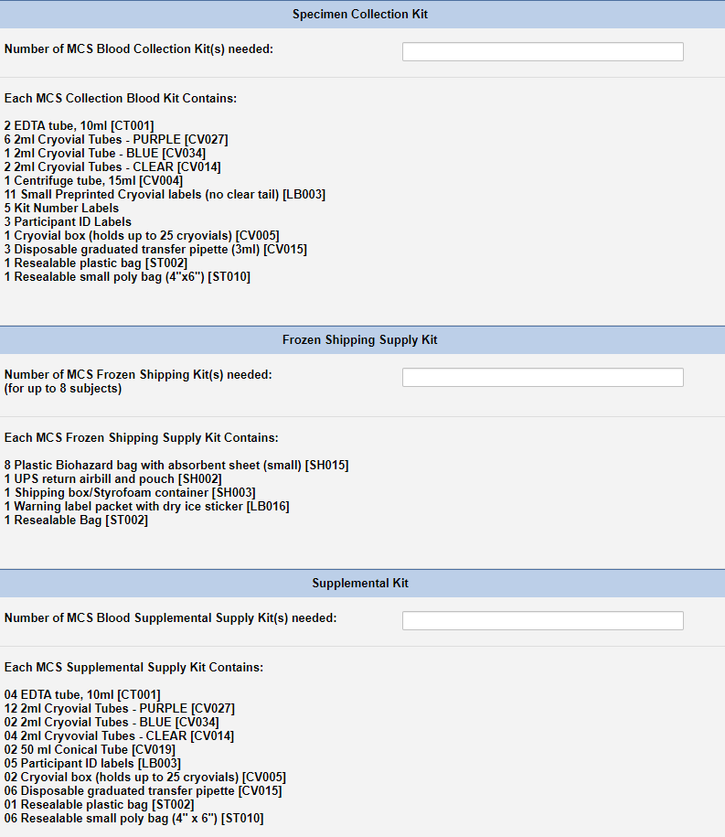
Kit Request Module Instruction
Verify site shipping address and contact information
Choose kit order amount
  Specimen Collection Kit
  Frozen Shipping Supply Kit
  Supplemental Kit
  Extra Supplies
*Reminder: allow two to three weeks for orders to be processed and delivered to your site

Slide 6
Specimen Labeling Instruction

Slide 7
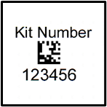



Specimen Labeling Instructions:
Label Type and Placement
Kit Number Label
Ties all visit samples and packaging together.
Must be placed on:
Whole-Blood 10 ml EDTA Tube (Purple-Top)
Blood Sample and Shipment Notification Form
Cryo-Box that houses processed aliquots
Participant ID Label
Unique PACT Participant ID written by site.
Must be placed on:
Whole-Blood 10 ml EDTA Tube (Purple-Top)
Cryovial Label
Contains NCRAD ID, Specimen Type, and Kit Number.
Must be placed on corresponding specimen type:
Cryovials 2 ml for aliquoted Plasma (Purple-Top) OR
Cryovials 2 ml for aliquoted Buffy Coat (Clear-Top)

Slide 8
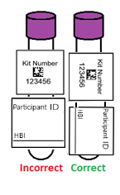
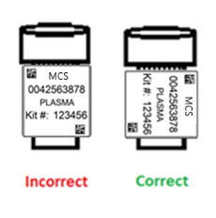
Specimen Labeling Instruction:
Label Placement Details
Write participant ID with fine-point sharpie prior to label placement
Place all labels on Whole-Blood EDTA 10 ml tube and Cryovial 2 ml before blood collection, processing, or freezing
Label collection tubes and cryovials for one subject at a time in order to avoid mix ups.
Wrap labels horizontally and adhere completely to all tubes
Collection Tube Labeling
Cryovial
Labeling

Slide 9
Specimen Collection and Processing

Slide 10
Specimen Collection and Processing:
Specimen Tube Types
Type | Cap Color | Size | Purpose | Amount
EDTA Tube | Purple | 10 ml | Whole blood collection | 2
Centrifuge Tube | Orange | 15 ml | Pooling plasma from EDTA tubes | 1
Cryovial | Lavender | 2 ml | 1.5 ml aliquots of plasma from Centrifuge tube | Up to 7
Cryovial | Blue | 2 ml | Aliquot residual plasma <1.5 ml after filling lavender top cryovials | 1
Cryovial | Clear | 2 ml | ~1.0 ml aliquots of buffy coat from EDTA tubes | 2

Slide 11
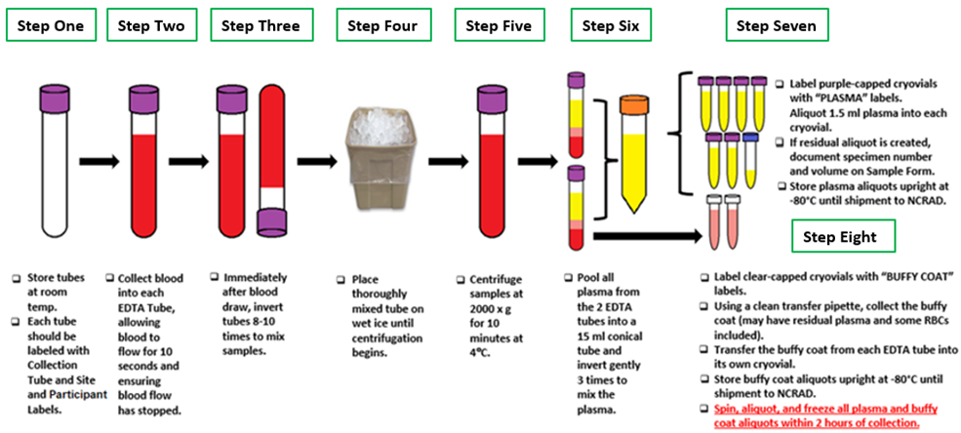
Specimen Collection and Processing:
Blood Collection and Specimen Processing

Slide 12
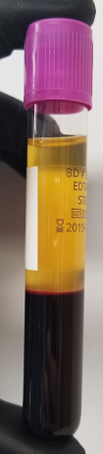
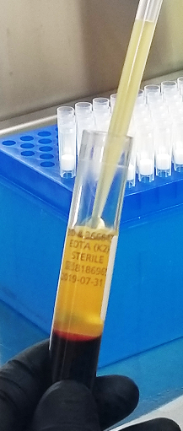
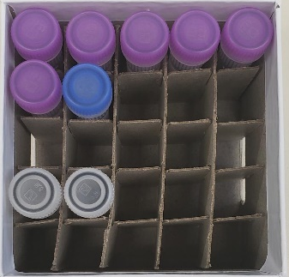
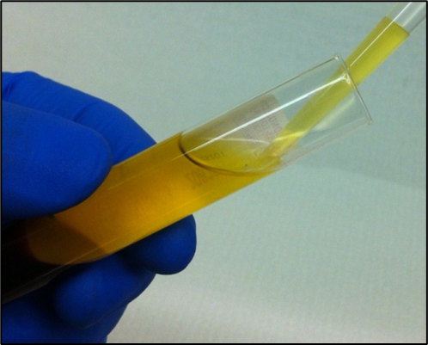
Specimen Collection and Processing:
Plasma Collection
Processed plasma creates up to seven
1.5 ml aliquots in lavender-top cryovials
Residual plasma is placed in blue-top cryovial
10 ml EDTA tubes after centrifuge
15 ml conical after inversion

Slide 13
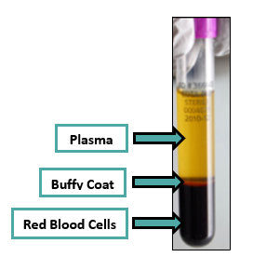
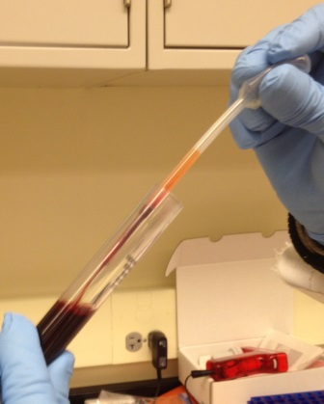
Specimen Collection and Processing:
Buffy Coat Collection
Buffy Coat
Aliquot ~1.0 buffy coat into two clear-capped cryovials
The buffy coat aliquot is expected to have a reddish color from the RBCs

Slide 14
Specimen Packaging, Labeling & Forms

Slide 15
Frozen Shipment Packaging
All samples shipped frozen to NCRAD Monday-Wednesday ONLY
Hold packaged samples in a -80°C freezer until pickup
Include copy of Blood Sample Shipment and Notification Form
Batch samples together (8 cryoboxes)

Slide 16
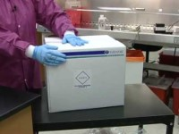
Frozen Shipment Tutorial

Slide 17
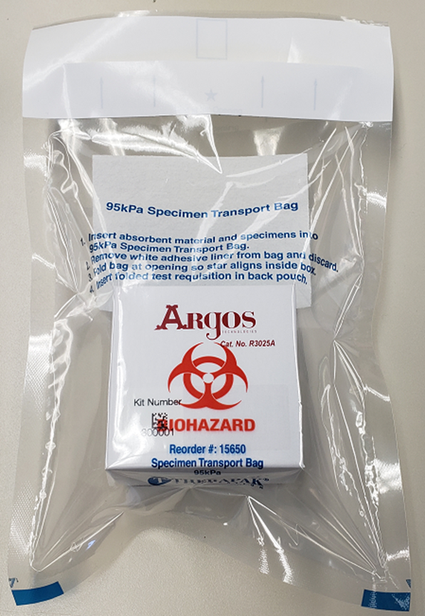
Specimen Packaging and Shipment:
Frozen Specimen Packaging
Step 1. Place frozen cryobox in biohazard bag with absorbent sheet
Important: Confirm kit number label has been placed on the outside of cryobox
Each Styrofoam shipper can contain up to 8 cryoboxes

Slide 18
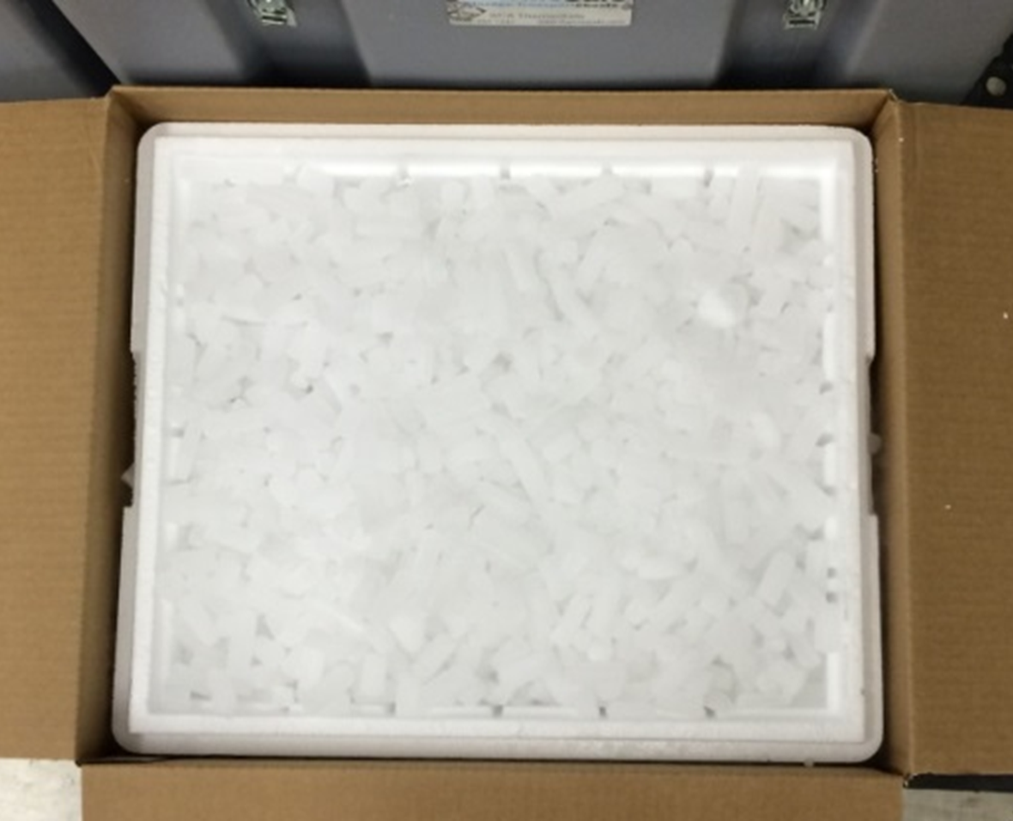
Specimen Packaging and Shipment:
Frozen Specimen Packaging
Step 2. Place 2-3 inches of dry ice in the bottom of the styrofoam shipping container
Step 3. Insert up to 8 cryoboxes laying upright
Step 4. Fully cover all cryoboxes with 2 inches of dry ice
Each Styrofoam shipper must contain 45 lbs. (20 kg) of dry ice
Important: Fill shipper to the top with dry ice

Slide 19
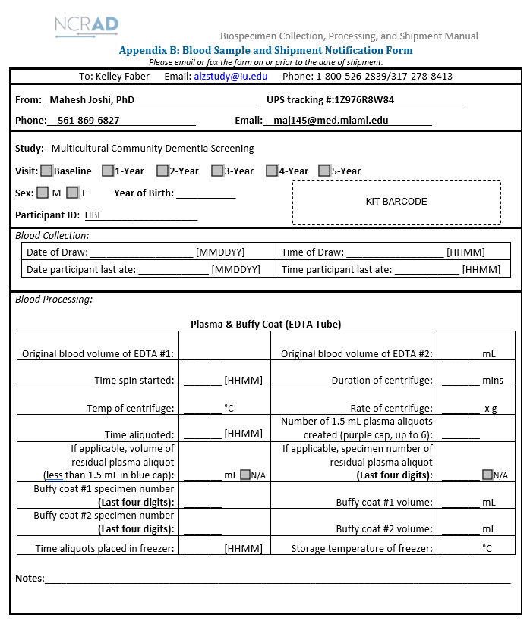
Blood Sample and Shipment Notification Form
Fill out completely during study visit
Include Kit Number Label on Form
Take a copy of each form prior to shipment. E-mail or fax NCRAD for notification
  Email: alzstudy@iu.edu
  Fax: 317-321-2003
Include Blood Sample and Shipment Notification Form in Large Cardboard Shipper

Slide 20
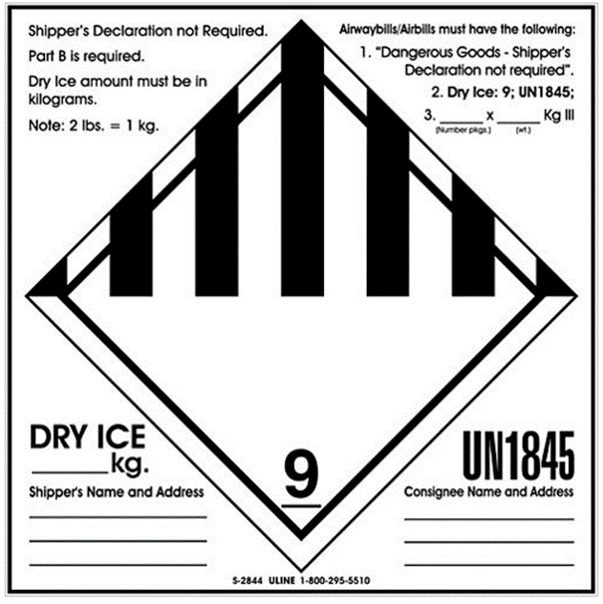

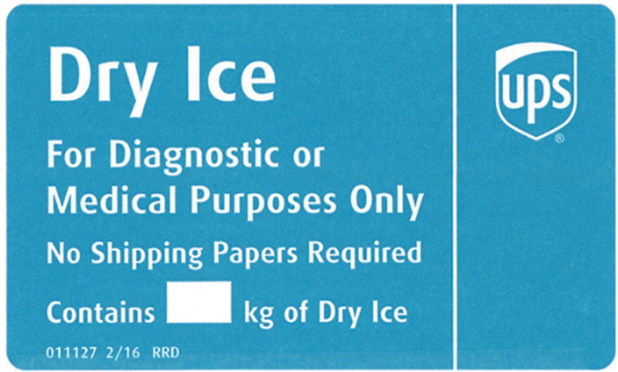
Specimen Packaging and Shipment:
Cardboard Package Labeling
Number of packages in shipment and dry ice in kg
Net weight of dry ice in kg
20
Net weight of dry ice in kg
Dangerous Goods Label
Additional Training Required
Your name & address
Repository name & address

Slide 21
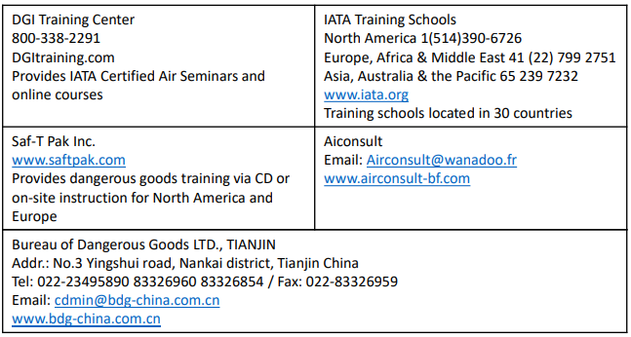
Specimen Packaging and Shipment:
Federal Shipping Regulations and Training
Important: It is the sites’ responsibility to ensure all study personnel responsible for shipping has received the appropriate IATA training for certification in biospecimen shipping
International Air Transport Association (IATA) Training

Slide 22
Specimen Packaging and Shipment:
UN3373 Biological Substance-Category B Training Resources
Training for UN3373 Biological Substance-Category B being transported for investigational purposes is recommended for study personnel
Find training information and further resources on the Department of Transportation website http://hasmat.dot.gov

Slide 23
Creating Airbills & Scheduling Pickups

Slide 24

UPS ShipExecTM Thin Client Website
Log into the ShipExec Thin Client: https://kits.iu.edu/UPS
Click on the “Shipping” dropdown and click on “Shipping and Rating”

Slide 25
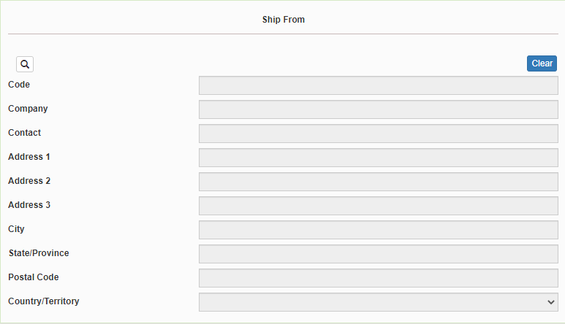
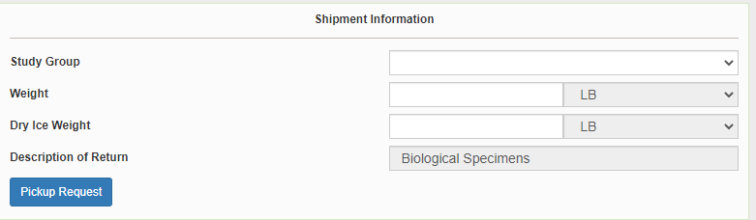
Creating Airbills & Scheduling Pick Ups:
Finding your Contact Information
On the right side of the screen, choose the name of your study from the “Study Group” drop down menu
  This step must be done 1st
On the left side of the screen, Click on the magnifying glass icon

Slide 26
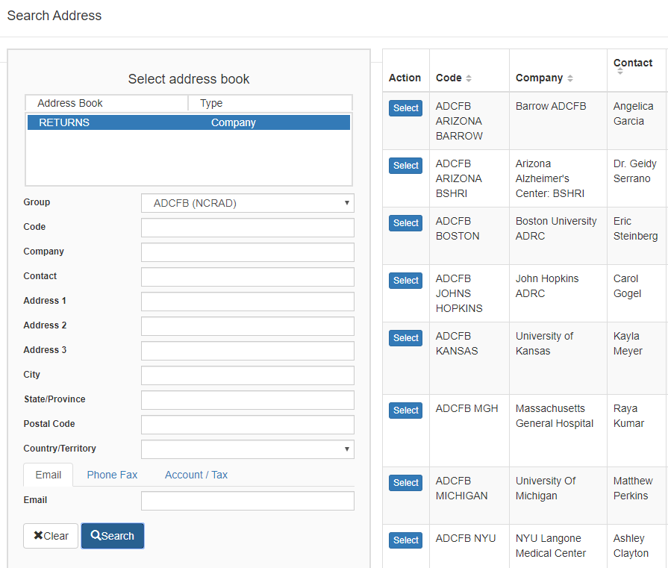
Creating Airbills & Scheduling Pick Ups:
Finding your Contact Information
On the right side of the screen, a list of all the site addresses within the study you selected should populate
User can filter the search for their address further by filling in the “Company”, “Contact”, or “Address 1” fields
Click “Search” when ready.
Once you have found your site address, click on the “Select” button to the left of the address
If any information needs to be updated, please reach out to the NCRAD Coordinator of your study

Slide 27
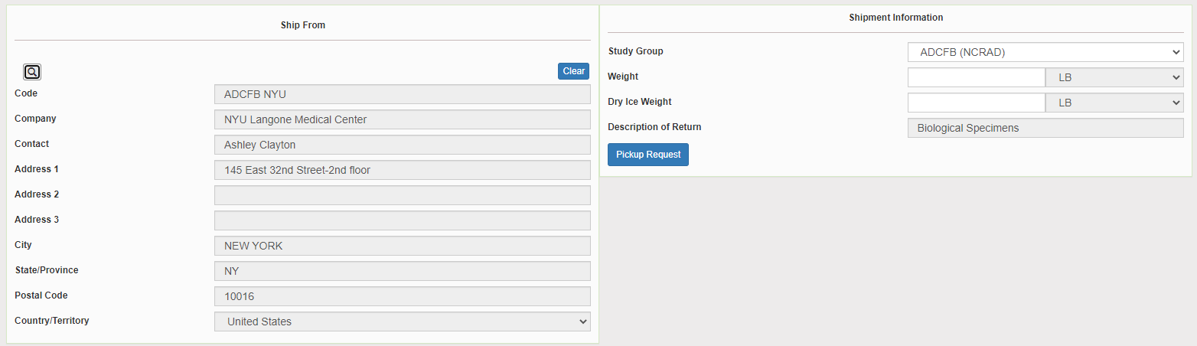
Creating Airbills & Scheduling Pick Ups:
Verify your Contact Information
Please verify that both the shipping information AND study reference are correct for this shipment

Slide 28
Creating Airbills & Scheduling Pick Ups:
Entering Shipment Information
    Enter the total weight of your package in the “Weight” field
    Enter the dry ice weight in the “Dry Ice Weight” field
      The “Dry Ice Weight” field cannot be higher than the “Weight” field (will receive an error message)

Slide 29
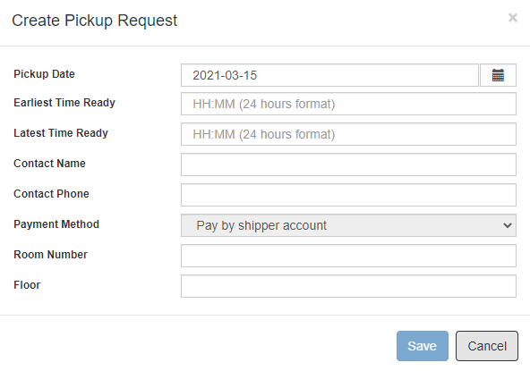
Creating Airbills & Scheduling Pick Ups:
Scheduling Pickup Request
Click on the “Pickup Request” button
Fill out all fields for the pickup request
Enter in the “Earliest Time Ready” and “Latest Time Ready” in 24-hour format
Choose a name and number that is the best to contact if the UPS driver has questions related to picking up your package
Entering the Room Number and Floor will help the UPS driver locate your package
Hit “Save” when done

Slide 30
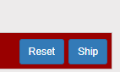
Creating Airbills & Scheduling Pick Ups:
Shipping Packages
If all fields in “Ship From” and “Shipment Information” fields are completed, and pickup request is completed (if necessary) then click “Ship” in the bottom right corner of the page

Slide 31


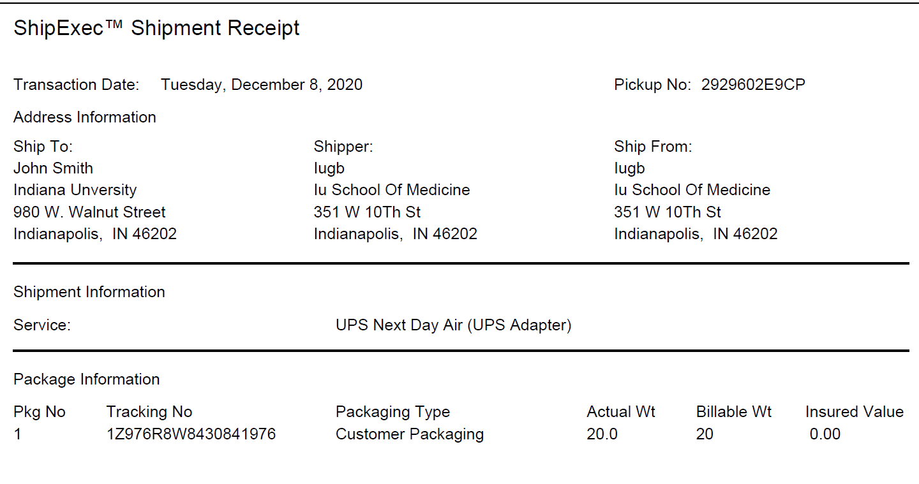
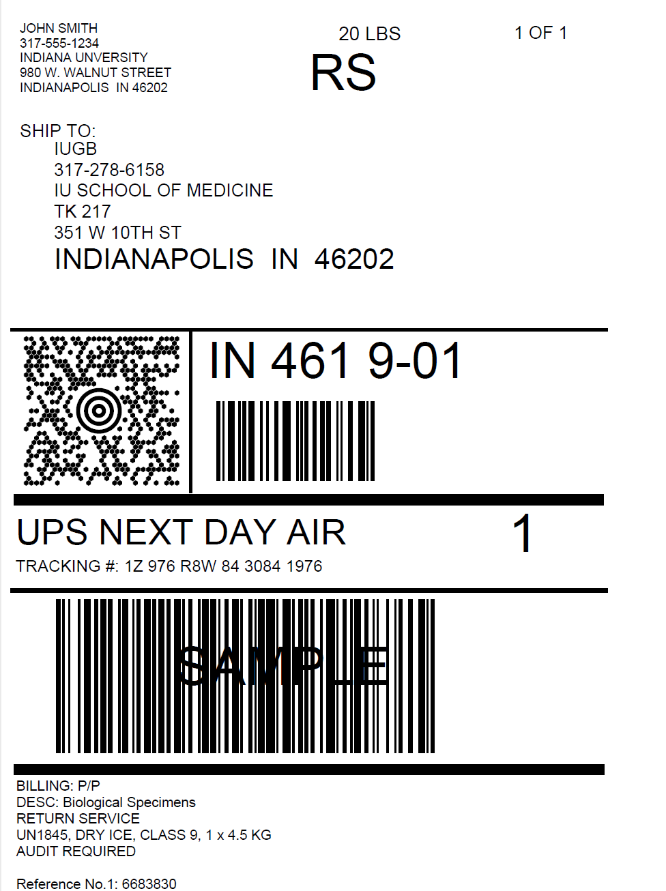
Check Pickup Status by going to UPS.com, click on the Shipping, select Schedule a Pickup, and look on the right side of screen to click on “Pickup Request Status”. Enter in the Pickup No. listed on receipt into PRN field and submit

Slide 32

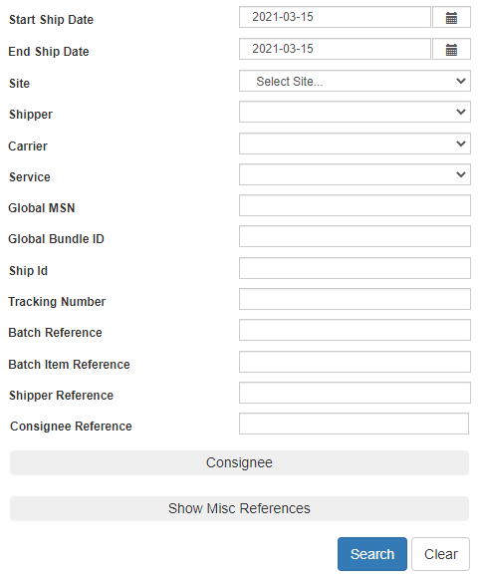
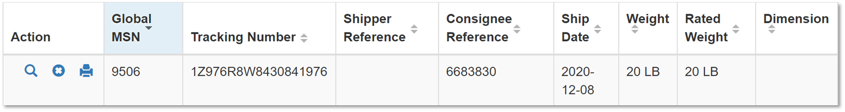
Creating Airbills & Scheduling Pick Ups:
Reprinting/Voiding Airbills
Reprint
Void
To reprint airbill or void a shipment, click “History” at the top of the ShipExec Thin Client portal
If your shipment doesn’t automatically pop up, enter in the date of shipment and then click “Search”

Slide 33
Creating Airbills & Scheduling Pick Ups:
Shipping Packages
Print out the UPS air waybill
Fold the UPS Air Waybill and slide it inside the plastic UPS Sleeve (Provided by NCRAD)
Peel the back off the plastic UPS sleeve and stick the sleeve to cardboard package
  Make sure it is laying as flat as possible along the surface of the package.

Slide 34
Non-Conformance Issues

Slide 35
Non-Conformance | Solution
Low volume aliquots | Put cryovials in a row, aliquoting in order until sample is depleted
Tubes received frozen at an angle/inverted | Carefully place tubes upright in freezer and in shipper
Aliquots are not labeled or labeled incorrectly | Refer to training or MOP for correct label placement. Save all labels until samples are packed for shipping.
All frozen samples for one participant are not sent within one shipment box | Keep plasma and buffy coat for individual subjects together. Use one cryobox per subject
Fields on Blood Sample and Shipment Form left blank or incorrect data is given | Complete Blood Sample and Shipment Form during participant’s study visit while samples are processed
Blood Sample and Shipment Forms are not e-mailed or faxed to NCRAD before shipment arrives | Make copy of participants completed form after visit and save until shipment.

Slide 36
Contact Information
Questions?
Please Contact NCRAD Coordinator at:
  Phone: 1-800-526-2839
  Study Coordinator E-mail: eridelan@iu.edu
  NCRAD General E-mail: alzstudy@iu.edu
  Website: www.NCRAD.org

